Slide 1
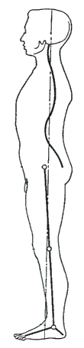
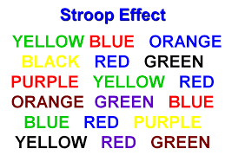
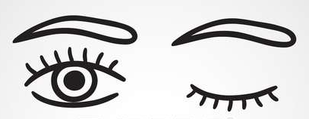
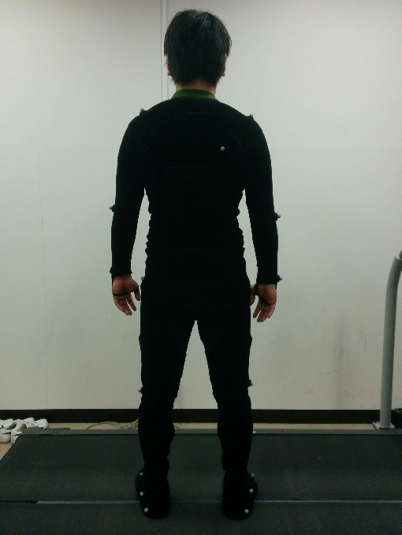

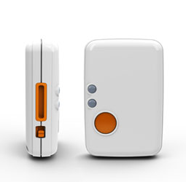
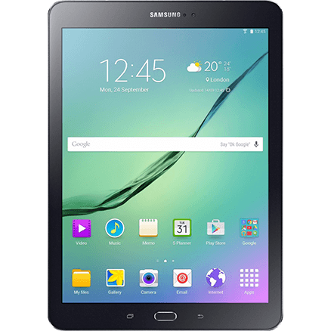
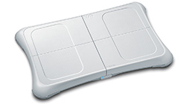
Quiet Standing Parameters for Clinically Usable System of Assessing Postural Stability Ray Fang, Jaeeun Yoo, Masahiro Shinya, Matija Milosevic, Kei Masani
Background
Methods of data collection
Three Conditions of Assessment:
Eyes closed, Eyes open, Stroop test
Wii Fit Board in place of force plate
IMU Sensor
Tablet to read board data
More cost-effective
More accessible
3-D Motion Analysis
Inverted Pendulum Model
2

